Slide 1


MEASURING
OUTCOME

Slide 2

FACILITATE THE GAM
E
This game is based on Evidence Based Management (EBM). EBM is an empirical framework organizations can use to help measure the (perceived) product value, and the way they deliver their product(s). The measurements can be inspected to help maximize product value and improve the way of working.
Scrum Facilitators is a Dutch-based training organization on a mission to help professionals become awesome Scrum facilitators. A Scrum Facilitator can be a Scrum Master, Product Owner, developer or leader. Great Scrum Facilitators understand the Scrum values & principles and use these to effectively implement Scrum with their teams and organizations.
Scrum Facilitators is a Scrum.org partner. Our classes are accredited, always up-to-date, fun, super interactive and always facilitated by two trainers to maximize your learning objectives. Our trainers are seasoned experts and Scrum.org certified Professional Scrum Trainers with substantial real life experience in various settings.
As a Scrum Facilitator, put the four Key Value Areas (KVAs) in a row on the floor (Current Value, Time to Market, Ability to Innovate and Unrealized Value). Explain each KVA to the participants.
Form two groups and hand one group the green Key Value Measures cards (KVMs) and the other group the remaining purple KVMs.
Step 1: Invite the group(s) to discuss and put the KVMs under the correct KVA.
Step 2: Invite both groups to discuss their results and adapt their cards. Make sure by the end of this round, the KVM cards are under the correct KVA.
Step 3: Invite the participants to individually look at the KVMs and select one KVM that caught their attention. (A non-EBM KVM may also be chosen at this point)
Step 4: Invite the participants into groups of four. Ask each participant to explain why they chose their particular KVM and collaborate on how to implement it. (In case of non-EBM measures, pay attention that these are not vanity metrics and discuss the potential pitfalls)
Based on the 2020 EBM Guide. Learn about Evidence-Based Management (EBM) at http://scrum.org/EBM
The Measuring Outcome game (v2) is licensed under
CC BY-NC-SA 4.0
By Scrum Facilitators

Slide 3
Change
Failure Rate

Slide 5
Desired Customer Experience or satisfaction

Slide 7
Time to remove Impediment

Slide 9
Time to Pivot

Slide 11
Production Incident Count

Slide 13
Lead Time
for Changes

Slide 15
Customer
Cycle Time

Slide 17
Time to
Restore Service

Slide 19
Active (Product) Code Branches

Slide 21
Time Spent Merging Code Between Branches

Slide 23
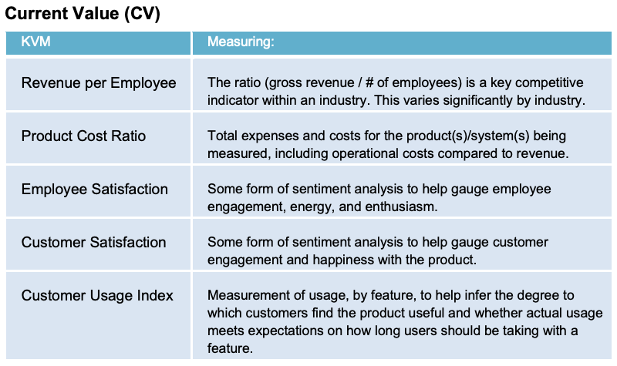
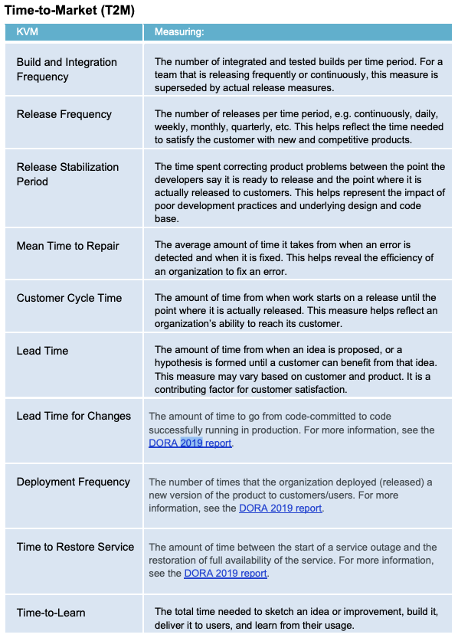
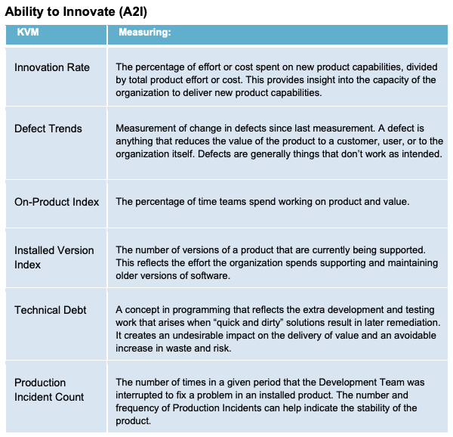
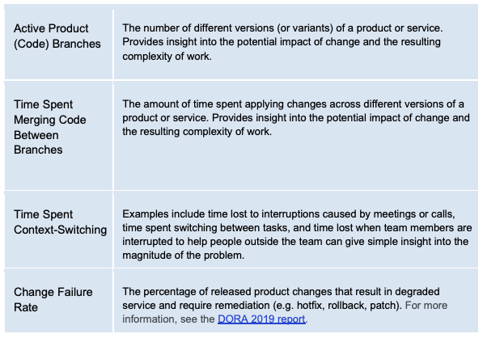
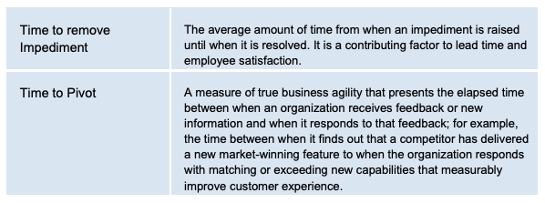
EBM Example Key Value Measures cheat sheet
Source: EBM guide 2020, http://scrum.org/EBM

